Slide 1


Inheritance & Interfaces
Samar Mansour

Slide 2
Inheritance
What is inherit?
It is a procedure in which one class inherit attributes and methods from another classes.
Inheritance concept have two categories:
Subclass (child): the class that inherit from another class.
Superclass (parent): the class being inherited from.
To inherit from a class, use the extends keyword.

Slide 3
Inheritance Example
Vehicle
Car
Truck
Maclaren
Lamborghini
Audi

Slide 4
Super keyword
When to use super keyword?
Super is essentially called from a child class that allows us to read and access features from the parent class regardless of their value in the current child class.
Super keyword used to:
Access parent class fields: super.var reads the value of var set in the parent class, while var alone reads the modified value from the child.
Calling a parent class method: super.method() allows the child to access the parent class implementation of method(). This is only required if the child class also has a method with the same name.
Using constructors: This allows you to create new instances of the parent class from within a child class.

Slide 5
Example Super keyword
class Parent {
public Parent(){
}
}
public class Child extends Parent {
public Child () {
super();
}
}

Slide 6
Typecasting
Java also allows you to reference a subclass as an instance of its superclass, essentially treating the subclass as if it were of the superclass type.
It is a great way to create modular code as you can write code that will work for any subclass of the same parent.
The two types of typecasting are:
Upcasting is when you treat a child class as if it were an instance of the parent class. Such as:
Car car = new Car();
Vehicle vehicle = car;
Any fields unique to the child class will be hidden to let them fit the mold of the parent class.
Downcasting is when an object can be downcast if the object was originally of the subclass type but was later upcast to the parent class.

Slide 7
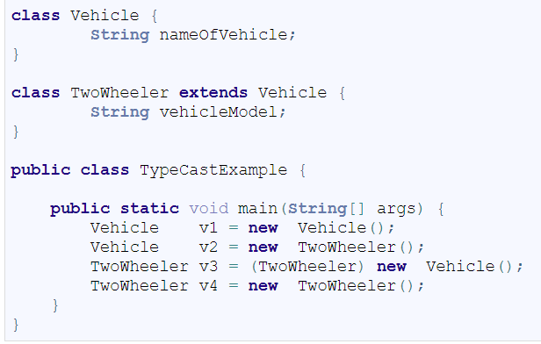
Upcasting and Downcasting Example
Up Casting :
You can cast an instance of a child class to its parent class. Casting an object of child class to a parent class is called upcasting.
Consider the following example, Assuming that TwoWheeler is a subclass of Vehicle.
Vehicle v2 = new TwoWheeler();
Down Casting :
Casting an object of a parent class to its child class is called downcasting.
Consider the following example, Assuming that TwoWheeler is a subclass of Vehicle. Following is an example of the down casting:
TwoWheeler v3 = (TwoWheeler) new Vehicle();

Slide 8
Final keyword
The final keyword can be used while declaring a variable, class, or method to make the value unchangeable.
The value of the entity is decided at initialization and will remain immutable throughout the program. Attempting to change the value of anything declared as final will throw a compiler error.
The exact behavior of final depend on the type of entity:
final Parameter cannot be changed anywhere in the function.
final Method cannot be overridden or hidden by any subclass.
final Class cannot be a parent class for any subclass.

Slide 9
Inheritance and overriding
When you extends a class, you can change the behavior of a method in the parent class.
This is called method overriding.
This happens when you write in a subclass a method that has the same signature as a method in the parent class.
If only the name is the same but the list of arguments is not, then it is method overloading.

Slide 10
Constructor and Inheritance
class Animal {
private String type;
public Animal(String aType) {
type = new String(aType);
}
public String toString() {
return "This is a " + type;
}
}
class Dog extends Animal {
public Dog(String aName) {
super("Dog");
name = aName;
breed = "Unknown";
}
public Dog(String aName, String aBreed) {
super("Dog");
name = aName;
breed = aBreed;
}
private String name;
private String breed;
}

Slide 11
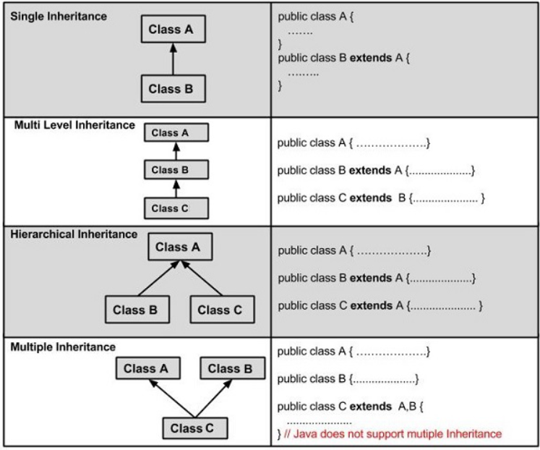
Types of Inheritance

Slide 12
Difference between Overloading and Overriding
Method Overloading | Method Overriding
Method overloading is in the same class, where more than one method have the same name but different signatures. | Method overriding is when one of the methods in the super class is redefined in the sub-class. In this case, the signature of the method remains the same.
void sum (int a , int b); void sum (int a , int b, int c); void sum (float a, double b); | class X{ public int sum(){ // some code } } class Y extends X{ public int sum(){ //overridden method , signature is same } }

Slide 13
Polymorphism
Polymorphism in Object Oriented Programming occurs when there are one or more classes or objects related to each other by inheritance. It is the ability of an object to take many forms.
There are two types of Polymorphism:
Dynamic Polymorphism in Java is the mechanism by which multiple methods can be defined with same name and signature in the superclass and subclass.
Static Polymorphism in Java is a type of polymorphism that collects the information for calling a method at compilation time, whereas Dynamic Polymorphism is a type of polymorphism that collects the information for calling a method at runtime.

Slide 14
Compile time Polymorphism
Compile time Polymorphism is nothing but method overloading in java. You can define various methods with same name but different method arguments.
Example:
MethodOverloading code in IntelliJ

Slide 15
Runtime Polymorphism
Runtime Polymorphism is nothing but method overriding in java.
If subclass is having same method as base class then it is known as method overriding Or in another word, If subclass provides specific implementation to any method which is present in its one of parents classes then it is known as method overriding.
Example:
Shape class

Slide 16
Access modifiers
The access modifiers in java define accessibility of variables, methods, constructor or class.
There are four types of access modifiers in java:
Public access modifier
private access modifier
protected access modifier
Package-private access modifier
Note:
We also have default access modifier, when we don’t modify the variable, method, and class.

Slide 17
Public access modifier
Public modifier is accessible in the whole java world. If you put class as the public that means that class is available everywhere.

Slide 18
private access modifier
The private access modifier is accessible only within class.
You can not use private and protected with class unless and until it is nested class.

Slide 19
protected access modifier
Protected access modifiers can be accessed within the same package or outside the package by inheritance only.

Slide 20
Package-private access modifier
If you do not provide any access, JVM considers it as default access. In the case of default access modifier, you can not access method, variable or class outside of the package.

Slide 21
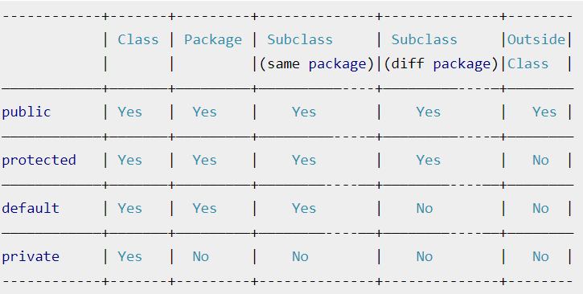
Summary Access Modifier Level

Slide 22
Interface

Slide 23
Interface
Interface is one of the core part of java and is used to achieve full abstraction.
Interface is generally used to provide contract for class to implement. Interface do not have implementation of any method.
A class implements an interface, thereby inheriting the abstract methods of the interface. So it is kind of signing a contract, you agree that if you implement this interface, then you have to use its methods. It is just a pattern, it can not do anything itself.
Note:
All the methods in the interface are by default public and abstract, all variables are public static final.

Slide 24
Interface and Inheritance
You can create inheritance in terms of interface too. An interface can only extend(extends) another interface.

Slide 25
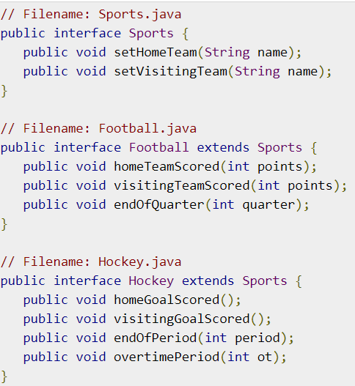
Extending Interfaces
An interface can extend another interface in the same way that a class can extend another class. The extends keyword is used to extend an interface, and the child interface inherits the methods of the parent interface.

Slide 26
Classes Extending Interfaces
A Java class can only extend one parent class. Multiple inheritance is not allowed. Interfaces are not classes, however, and an interface can extend more than one parent interface.
Example:
public interface Hockey extends Sports, Event

Slide 27
Importing points about Interfaces
You need to use “Interface” keyword to declare an interface.
An interface can not have any method implementation.
Interface methods are by default public abstract.
Interface variables are by default public static final.
implements keyword is used by class to use interface.
One interface can not extend another class bit can extend another interface using extends keyword.
A class needs to override all methods of interface unless it is abstract class, otherwise, you will get compilation errors.

Slide 28
Marker Interface
An interface that does not contain methods, fields, and constants is known as marker interface. In other words, an empty interface is known as marker interface or tag interface.
It provides run-time type information about objects, so the compiler and JVM have additional information about the object.
Note:
Java has many built-in marker interfaces, such as
Serializable, Cloneable, and Remote.

Slide 29
Cloneable Interface
Cloneable interface is present in java.lang package.
There is a method clone() in Object class.
A class that implements the Cloneable interface indicates that it is legal for clone() method to make a field-for-field copy of instances of that class.

Slide 30
Clone() Method
Object cloning refers to the creation of an exact copy of an object.
It creates a new instance of the class of the current object and initializes all its fields with exactly the contents of the corresponding fields of this object.

Slide 31
Shallow Copy and Deep Copy
Shallow Copy: is the method of copying an object and is followed by default in cloning.
Shallow copies are cheap and simple to make.
Deep Copy: Deep repetition truly clones the underlying data. It is not shared between the first and therefore the copy.

Slide 32
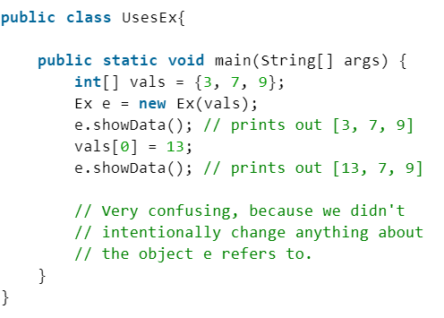
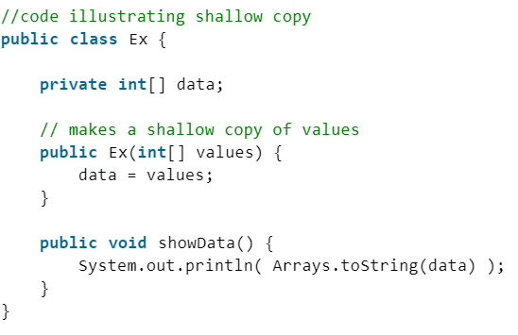
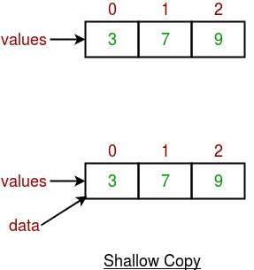
Shallow copy example
data simply refers to the same array as values.

Slide 33
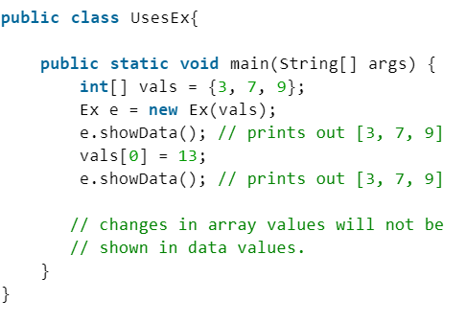
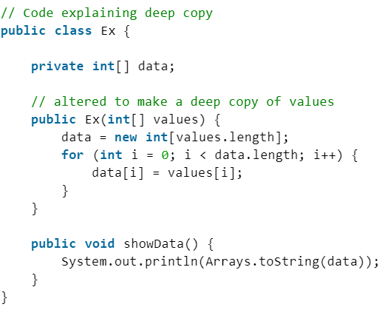
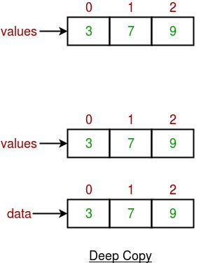
Deep Copy Example

Slide 34
Shallow Copy vs. Deep Copy
Shallow Copy | Deep Copy
Shallow Copy stores the references of objects to the original memory address. | Deep copy stores copies of the object’s value.
Shallow Copy reflects changes made to the new/copied object in the original object. | Deep copy doesn’t reflect changes made to the new/copied object in the original object.
Shallow Copy stores the copy of the original object and points the references to the objects. | Deep copy stores the copy of the original object and recursively copies the objects as well.
Shallow copy is faster. | Deep copy is comparatively slower.

Slide 35
Serializable interface
Serializable interface is present in java.io package. It is used to make an object eligible for saving its state into a file. This is called Serialization.
Classes that do not implement this interface will not have any of their state serialized or deserialized.
All subtypes of a serializable class are themselves serializable.
Example:
https://www.geeksforgeeks.org/marker-interface-java/

Slide 36
The Object Class
As we talked before, every class in java inherent from object class. The object class have a 11 methods.
The important methods that we’ll look about it:
hashCode(): returns the hash code number for this object.
toString(): returns the string representation of this object.
equals(Object): compares the given object to this object.

Slide 37
